Slide 1



Life history pathways of wild spring Chinook salmon from the McKenzie basin
Luke Whitman*
Kirk Schroeder
Brian Cannon
Ben Clemens
Corvallis Research Lab
Oregon Department of Fish and Wildlife
Funded by the U.S. Fish & Wildlife Service, Sport Fish Restoration
and the Oregon Department of Fish and Wildlife
Additional Support from USACE

Slide 2
Project Background
Started in 1996 to study wild spring Chinook salmon in the Willamette and Sandy basins
Populations listed as threatened in 1999, began collecting data for the recovery plan
Initial genetic identification; fall and spring Chinook
Hooking mortality in fishery below Willamette Falls
Complete census of all spawning habitat in the Willamette and Sandy basins
Juvenile life history investigations started early 2000’s

Slide 3
Objectives
Identify different pathways to inform management
  Habitat, growth, migration timing, expression in adult spawners
Understand environmental conditions that may affect different pathways, migration timing
Identify freshwater habitat potentially limiting juvenile production
Identify overlap with hatchery and wild juveniles
Composition of the spawning population, understand differences among brood years
Notes:
Won’t be able to answer all of these questions, but they guide our research. Identify life histories and habitat types. Operate hatchery program to minimize impacts on wild fish (timing, rearing, etc.). Acclimation studies (returns to fishery). Document spawner composition. Needed to ID hatchery fish through mass marking (clipping and otolith marking) late 1990’s. Lots of data from the N. and S. Santiams, will focus on the McKenzie. What’s left with life history diversity.

Slide 4
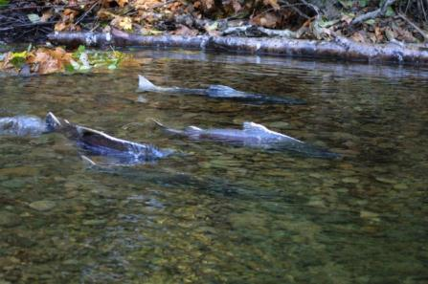
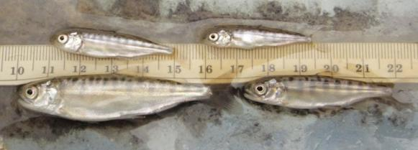
McKenzie River
Most Intact watershed
Largest wild population
Spawners have access to upper river
Reach | Spawners (%) | Wild Spawners (%)
Above South Fork | 54 | 88
South Fork & below | 31 | 52
Below Leaburg Dam | 15 | 12
Notes:
Template for wild fish life histories, provide information for recovery strategies. E.g., holding fish in reservoirs, fry passage. Looking at whole basin in our approach, historic spawning habitat use of the entire basin, out through mainstem Willamette (back to funding, small, specialized projects).

Slide 5
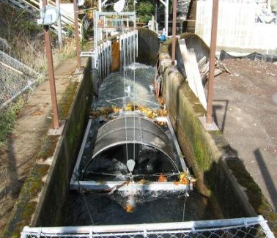
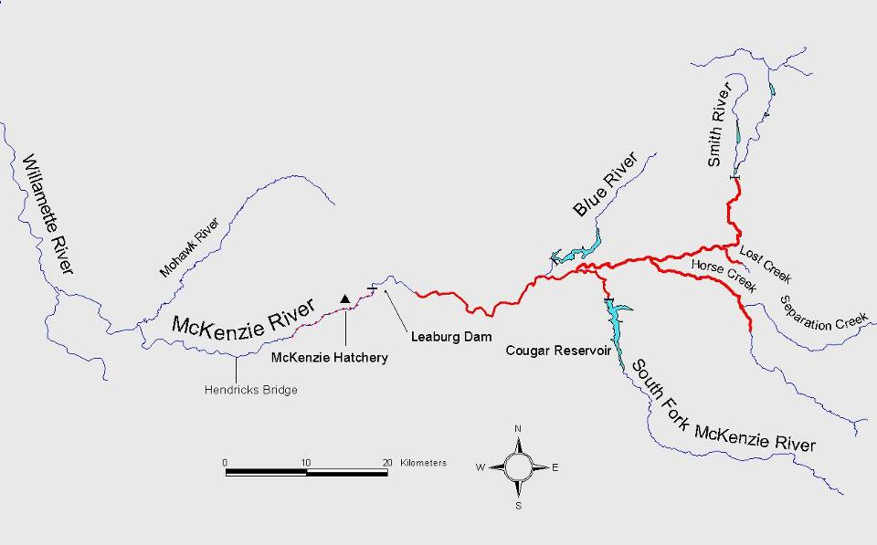
Sampling Areas
Leaburg Bypass
Snorkel Seining
Beach Seining
Fry Seining the entire river and Horse Creek
Notes:
Insert shapes to highlight the areas we sample; Leaburg, lower river beach seining, upper McKenzie and Horse Creek. Mainstem Willamette for fry and juveniles (subyearling) too…

Slide 6
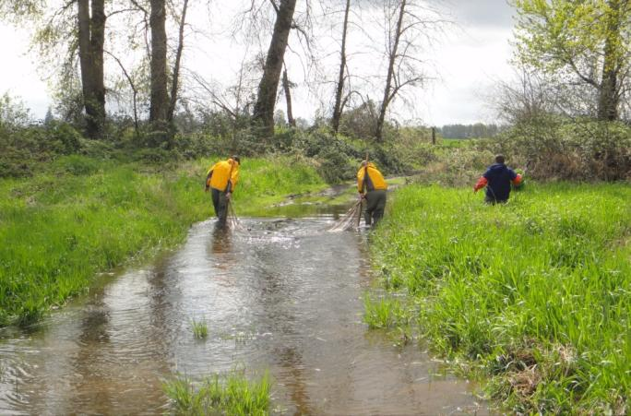
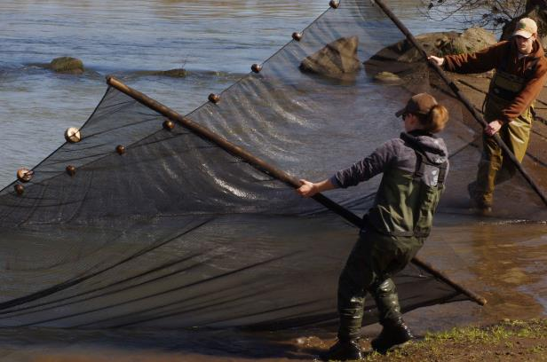
Fry Seining
McKenzie, Horse Creek, and Willamette; December - May
Chose sites with less current where we could pull our seine
Pole seine: 20’x 6’
with 1/8” mesh
Count and measure all Chinook fry
2010-2012; visited sites twice a month
Notes:
Needed to choose sites we could access at different flows, e.g., boat ramps, gravel bars, beaches.

Slide 7
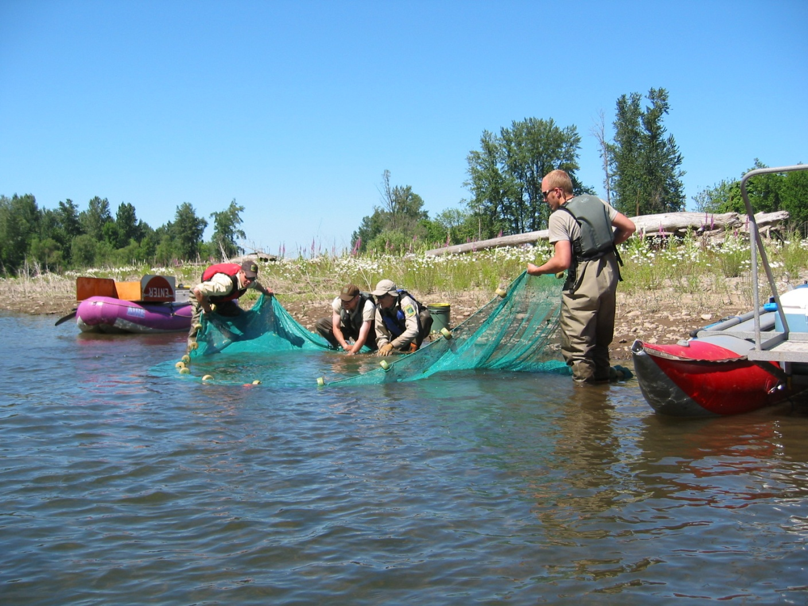
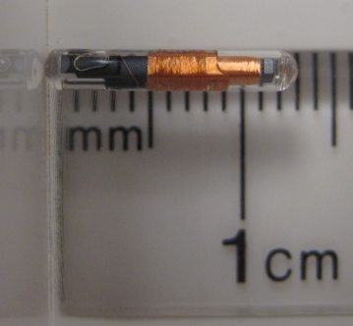
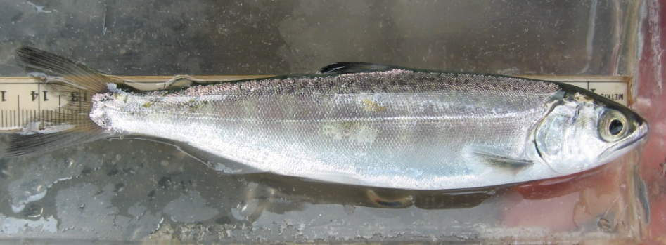
Beach Seining
Lower McKenzie and Willamette, May - August
Boat used to set seine: 150’ x 8’ with ¼” mesh
Apply 12 mm PIT tag to all Chinook over 65 mm
Recapture fish through continued seining
2007-2014; ~8,000 tags per year
Notes:
We stop seining these different areas when water temperatures reach 18 C. Most of our effort is May through July. Lower McKenzie in August (some).

Slide 8
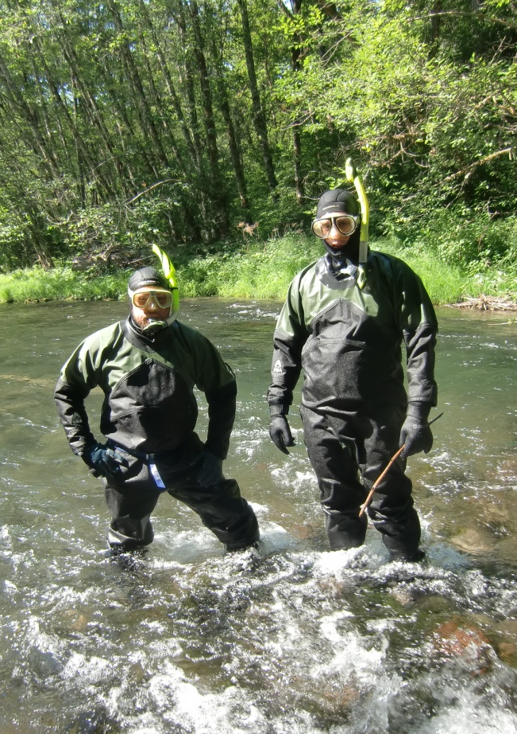
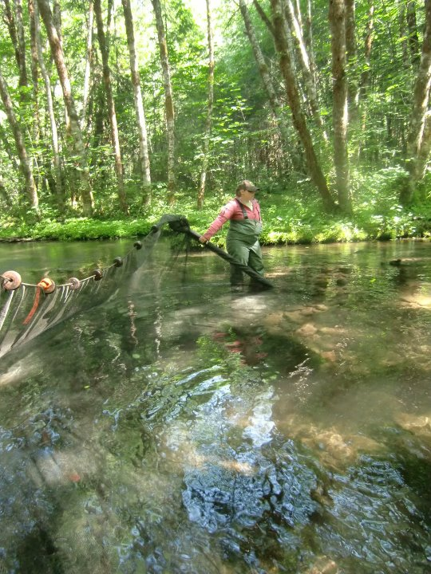
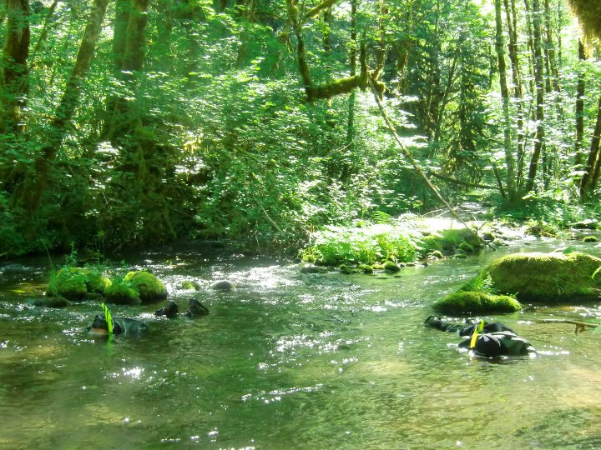
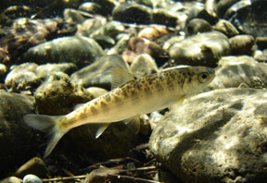
Snorkel Seining
Upper McKenzie mainstem and Horse Creek; August- October
Snorkelers locate groups of fish and push them in to a seine downstream
Pole seine: 20’x 6’
with 1/8” mesh
Apply 12 mm PIT tag to all Chinook over 65 mm
Recapture fish through continued seining and at Leaburg Dam
2011-2014, ~2,500 tags per year

Slide 9
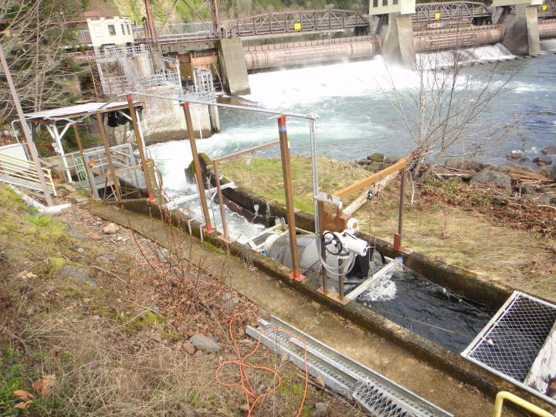
Leaburg bypass
Trap operated mid-October through April
Apply 12 mm PIT tag to all Chinook over 65 mm
Count and measure fry
PIT antennae in the bypass
2007-2014; ~4,000 tags per year
Notes:
Tag about 4,000 smolts fall and spring combined. Most fish tagged in the fall.

Slide 10
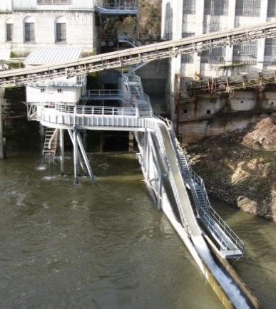
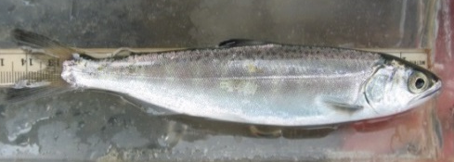
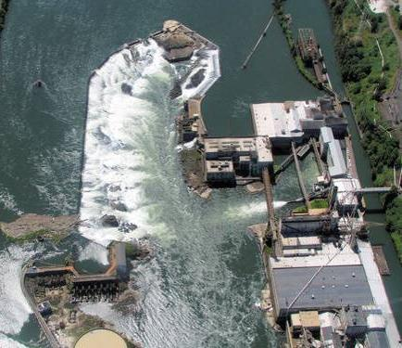
Willamette Falls
Detection Sites
Two antennae: North Fish Bypass and Turbine 13
Proportion of fish depends on flow and guidance efficiency
Developed expansion factors to estimate the proportion of smolts moving through the plant
PGE Sullivan Hydroelectric Plant
Fish bypass PIT antenna
Notes:
PGE radio tagged study upstream of fall and our release of PIT tagged fish upstream of falls (using smallest hatchery fish, similar to the size of wild smolts 170 mm or less). Two bypass routes, both with antennae. Turbine 13

Slide 11
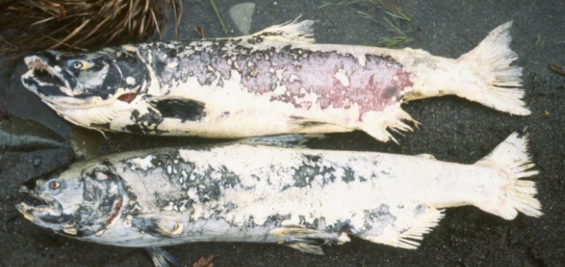
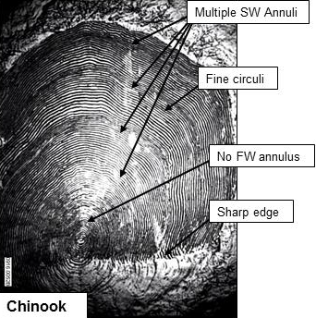
Adult scale analysis
Carcasses sampled on the spawning grounds
Scales read for age and life history
First annulus after saltwater entry = subyearling migrant (age-0)
First annulus before saltwater entry = yearling migrant (age-1)

Slide 12
Data analysis
Fry:
  Temperature used to predict emergence timing
  Presence or absence by area
  CPUE (seine sets)
PIT tagged juveniles:
  Summarized by brood year
  Estimated percentages following a given life history pathway based on detections at Leaburg and Willamette Falls
  Detections at Willamette Falls expanded based on flow
  Standardized per 1000 fish tagged
Spawners:
  Estimated proportions of subyearlings and yearlings once all adults from a brood year had returned (age-2 t0 age-6)
  Model building with a suite of environmental variables, periods chosen based on rearing patterns
Notes:
X

Slide 13
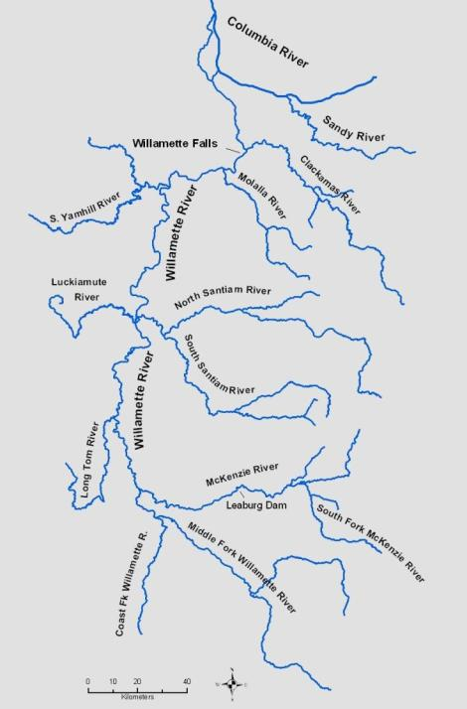
Fry Dispersal
Wide range of emergence timing
Fry first caught in January
Fry dispersed throughout the Willamette by late February
Peak catch:
  Upper McKenzie and Horse Creek – April
  Leaburg – March
  Lower McKenzie - February
Notes:
Double check timing at Leaburg, don’t always get good counts.

Slide 14
Juvenile Life History Pathways
Spawning area
Movers
Stayers
Precocial
Leaburg/Lower McKenzie
Fall-winter
Spring
2-year
smolt
76%
24%
Willamette River rearing
24%
76%
<1%
15%
24%
9%
52%
Migration past Willamette Falls
Fry
migrant
Subyearling
smolt
Summer
migrant
Fall-winter migrant
Yearling
smolt
Jan
Feb
Mar
Apr
May
Jun
Jul
Aug
Sep
Oct
Nov
Dec
Jan
Feb
Mar
Apr
May
Jun
For PIT tagged juveniles
11%
11%
78%
Notes:
Kirk: start at redds and emergence. Refer to fry dispersal with movers. Walk through the pathways. Stayers detections at Leaburg of fish tagged in Horse Creek and upper McKenzie. All tagged in summer, % detected in fall and spring. Need better estimates of fry numbers past Leaburg and estimate fry remaining on spawning ground. These numbers for fish from a given brood year, standardized for every 1000 fish tagged. We tag more of certain groups. Remember dotted lines mean we don’t know the number or fall/winter migrants are they migrating to the estuary. Fry migrants to estuary? Subyearling smolts? May be part of life history X, any area with major growth spurt in productive mainstem habitat. Accelerated winter growth (Mattson 1962). Lots of different productive habitats with various pathways, many different growth patterns. Difficult to assume one specific scale pattern (why we focused on subyearling vs. yearling with SW check mark). Make sure to point out # years and tag numbers – impressive effort, don’t forget this.

Slide 15
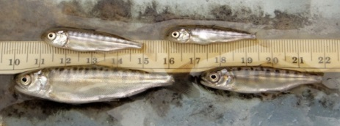
Length of spring Chinook salmon captured as fry (●) or juveniles (■)
Willamette and upper McKenzie rivers
Notes:
Point out that not much migration from the upper river after March – not just that all the big fish are leaving (unknown recruitment). In May, some of the larger fish leaving the Willamette habitat. Potential threshold for migration, upper McKenzie fish need more time to reach the size and body condition needed to migrate (6+months additional rearing). Following spring migrants show same threshold (a little smaller for movement in mainstem Willamette. Wide range of size and growth later in the spring. Blue = Willamette, Green = McKenzie

Slide 16
Life History of Spawners
80% yearling, 20% subyearling on average
Variation from year to year
Subyearlings persist, important some years
Life history can affect age at return
Subyearling
Notes:
10 complete brood years from the scale analysis. Subyearlings more than 50% some years. Both life histories need to be protected, maximum conservation benefits. Still don’t know which life history was the largest producer historically, may not line up with management goals. We don’t know which LF will provide the most conservation benefit – increase adult returns. Think about management decisions from only looking at one or two years.

Slide 17
River conditions
The proportion of subyearlings positively correlated with winter flows in the McKenzie
Weaker relationships with other variables (Columbia, mainstem Willamette, etc.)
Notes:
Model building with river conditions. Incubation and emergence period in McKenzie. Need to look at whole basin as potential rearing habitat, have the capacity to migrate at small size. Check temperature, rain driven system, more flows are warmer – need to compare to emergence timing and drive a subyearling life history (e.g., south Santiam).

Slide 18
Summary
Fry begin moving soon after emergence, to lower McKenzie and Willamette
78% of PIT tagged juveniles from the McKenzie migrate as yearlings; 22% as subyearlings
Smolts begin to migrate around 100 mm FL
Spawners 80% yearling, 20% subyearling migrants

Slide 19
Discussion
Rearing takes place in many different freshwater habitats, leading to many different growth patterns
Identify environmental conditions affecting migration timing of different groups of smolts
Identify important freshwater habitat to guide restoration
Continue analysis on factors affecting the proportion of yearling and subyearlings
Tie all this into changes in adult population
Two manuscripts in preparation
Notes:
Subyearlings: 2 potential advantages, less time in FW may have better survival. Return as adults as 4 yr olds, less affect from commercial fishery in AK and BC in ocean fisheries. Willamette is an early run (early Feb-March) catch and release from sport anglers. Adapted to flows at WF with different spring flows. Rearing habitat = whole basin + estuary. Long-term, adult scale patterns capture everything. Fast migration – rearing in much different habitat – them more rapid migration. Dams on spawning tribs lead us to focus on tribs independent of conditions on the mainstem willamette. Understand each component of life cycle, various advantages and disadvantages. Smolt production, adult survival, total adult returns. Any limiting habitat in FW. Timing is crucial, when they hit the ocean, etc. Timing of estuary and ocean entry may be important to growth and migration timing of fish rearing in FW. May have the ability to affect certain timing with improvements in FW.

Slide 20
Spawning area
?
?
?
Movers
Stayers
Precocial
Fall-winter
Spring
2-year
smolt
76%
24%
Willamette River rearing
24%
76%
<1%
15%
24%
9%
52%
Migration past Willamette Falls
Fry
migrant
Subyearling
smolt
Summer
migrant
Fall-winter migrant
Yearling
smolt
Jan
Feb
Mar
Apr
May
Jun
Jul
Aug
Sep
Oct
Nov
Dec
Jan
Feb
Mar
Apr
May
Jun
Pattern X ?
11%
11%
78%

Slide 21
Acknowledgments
Field Staff: Paul Olmsted, Sara Akins, David Hewlett, Eric Bailey, many others over the years
Administration: Tom Friesen, Cam Sharpe
District Biologists: Jeff Ziller, Kelly Reis
Scale Analysis: Lisa Borgerson, Kanani Bowden
Leaburg: Mike Hogansen
PIT Antennae: Gabriel Brooks, Jody White, Biomark
PGE Sullivan Plant: Tim Shibahara, Dan Cramer

